Slide 1


SOFTWARE ENGINEERING (Week-1)
Usama Musharaf
Lecturer (Department of Computer Science)
FAST-NUCES Peshawar

Slide 2
Course Content
Introduction to Computer‑based System Engineering;
Project Management; Software Specification; Requirements Engineering, System Modeling; Requirements Specifications; Software Prototyping;
Software Design: Architectural Design, Object‑Oriented Design, Function‑Oriented Design, User Interface Design;
Quality Assurance; Processes & Configuration Management;
Introduction to advanced issues:
Reusability, Patterns;
Assignments and projects on various stages and deliverables of SDLC.

Slide 3
Recommended Books
Text Books
Software Engineering, Sommerville I., 10th Edition, Pearson Inc., 2014
Software Engineering, A Practitioner’s Approach, Pressman R. S.& Maxim B. R., 8th Edition, McGraw-Hill, 2015.

Slide 4
Objective of this Course
To familiarize students to the fundamental concepts, techniques, processes, methods and tools of Software Engineering,
To help students to develop basic skills that will enable them to construct software of high quality software that is reliable, and that is reasonably easy to understand, modify and maintain.

Slide 5
Evaluation Criteria
Assessment | Weightage
Assignment | 10%
Quiz | 10%
Sessional 1 | 15%
Sessional 2 | 15%
Final Exam | 50%

Slide 6
Weekly plan
Week | Topics
Week 1 - 3 | Intro to Software Engineering, Importance of Software Engineering, Brief overview of Software Engineering Phases, Agile Development (Extreme Programming) Agile Development Cont…. (Scrum), Introduction to DevOps Intro to Software Quality Engineering, Quality Models, Quality Engineering at SDLC phases. Requirement Engineering, Quality Engineering at RE phase.

Slide 7
Weekly plan
Week | Topics
Week- 4 - 7 | Software Architecture Software Architectural Styles, Quality Engineering at Design and Architecture phase. Quality attributes (performance, scalability, reliability, security)
Week 8 - 9 | Quality Engineering at Code Phase Software Configuration Management, Version Control System, GIT, GIT Hub,

Slide 8
Weekly plan
Week | Topics
Week- 10 - 12 | Software Testing, Black Box, White Box, Software Testing with JUNIT.
Week 13 - 15 | Software Deployment Issues in the deployment of large scale software systems A Brief overview of Deployment Technology Stack (Deployment with virtual machines, containers, … Containerizing an application from scratch, Deployment on cloud. CI/CD pipeline.

Slide 9
Contents of week # 1
Introduction to Software Engineering
Importance of Software Engineering
Agile Software development

Slide 10
What is Software Engineering?
Systematic approach for developing software
Methods and techniques to develop and maintain quality software to solve problems.
Study of the principles and methodologies for developing and maintaining software systems.

Slide 11
What is Software Engineering?
Practical application of scientific knowledge in the design and construction of computer programs and the associated documentation required to develop, operate, and maintain them.
Deals with establishment of sound engineering principles and methods in order to economically obtain software that is reliable and works on real machines.

Slide 12
What is Software?
According to the IEEE
Software is:
“Computer programs, procedures, and possibly associated documentation and data pertaining to the operation of a computer system”.

Slide 13
The Role of Software Engineering
A bridge from customer needs to programming implementation
Customer
Software Engineering
Programmer
First law of software engineering
Software engineer is willing to learn the problem domain
(problem cannot be solved without understanding it first)

Slide 14
Some Important Software Engineering Related Activities
Project Management
Requirement Engineering
Software Design
Coding
Testing
Software Quality Assurance
Software Configuration Management
Software Deployment

Slide 15
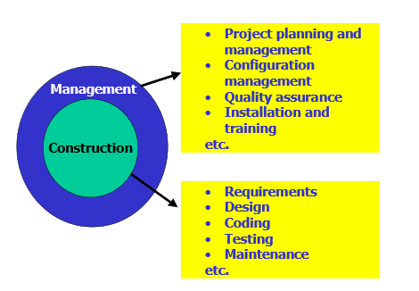
Software Development

Slide 16
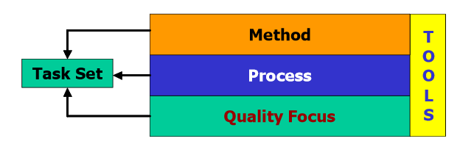
Software Development

Slide 17
Agile Development

Slide 18
What is “Agile”?
Agile is a philosophy or a way of thinking guided by some values and principles.

Slide 19
What is “Agility”?
Effective (rapid and adaptive) response to change
Effective communication among all stakeholders
Yielding …
Rapid, incremental delivery of software

Slide 20
Agile values
Individuals and Interactions over Processes and Tools
Working Software over Comprehensive Documentation
Customer Collaboration over Contract Negotiation
Responding to change over Following a Plan

Slide 21
Principles of agile methods

Slide 22
Agile process models
Extreme Programming (XP)
Scrum
Adaptive Software Development
Dynamic System Development Method (DSDM)
Crystal
Feature Driven Development
Agile Modeling (AM)

Slide 23
Extreme Programming (XP)
Perhaps one of the well-known and most widely used agile method.
Extreme Programming (XP) takes an ‘extreme’ approach to iterative development.
New versions may be built several times per day;
Increments are delivered to customers every 2 weeks;
All tests must be run for every build and the build is only accepted if tests run successfully.

Slide 24
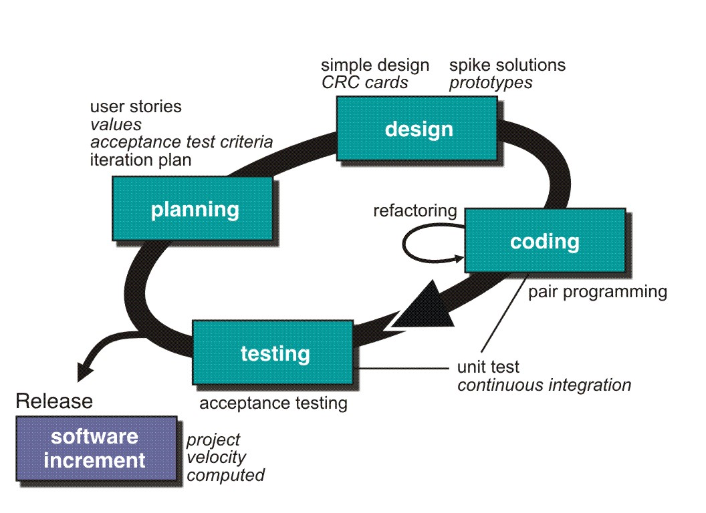
Extreme Programming (XP)

Slide 25
Extreme Programming (XP)
XP Planning
Begins with the creation of user stories
Agile team assesses each story and assigns a cost
Stories are grouped to for a deliverable increment
A commitment is made on delivery date

Slide 26
Requirements scenarios
In XP, user requirements are expressed as scenarios or user stories.
These are written on cards and the development team break them down into implementation tasks. These tasks are the basis of schedule and cost estimates.
The customer chooses the stories for inclusion in the next release based on their priorities and the schedule estimates.

Slide 27
Story card for document downloading

Slide 28
Extreme Programming (XP)
XP Design
Follows the KIS (keep it simple) principle
Encourage the use of CRC (class-responsibility-cards) cards
For difficult design problems, suggests the creation of spike solutions — a design prototype
Encourages refactoring — an iterative refinement of the internal program design

Slide 29
Extreme Programming (XP)
CRC Cards:
Class-responsibility-collaboration (CRC) cards are a tool used in the design of object-oriented software.

Slide 30
Extreme Programming (XP)
CRC Cards:
The card is partitioned into three areas:
On top of the card, the class name
On the left, the responsibilities of the class
On the right, collaborators (other classes) with which this class interacts to fulfill its responsibilities.

Slide 31
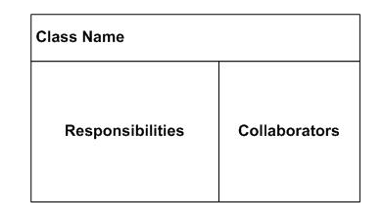
Extreme Programming (XP)
CRC Cards:

Slide 32
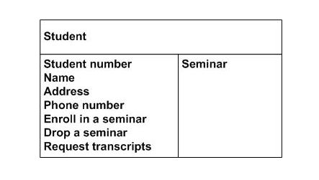
Extreme Programming (XP)
CRC Cards:

Slide 33
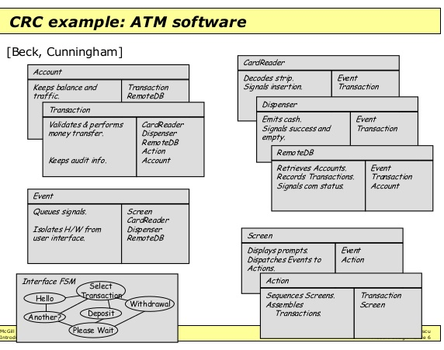

Slide 34
Extreme Programming (XP)
XP Coding
Recommends the construction of a unit test for a store before coding commences
Encourages pair programming
XP Testing
All unit tests are executed daily
Acceptance tests are defined by the customer and executed to assess customer visible functionality

Slide 35
Testing in XP
Test-first development.
Incremental test development from scenarios.
User involvement in test development and validation.

Slide 36
Task cards for document downloading

Slide 37
Test case description

Slide 38
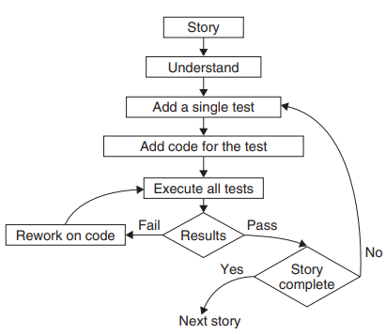
Unit testing in extreme programming

Slide 39
Significance of Test-first development
Writing tests before code clarifies the requirements to be implemented.
Tests are written as programs rather than data so that they can be executed automatically. The test includes a check that it has executed correctly.
All previous and new tests are automatically run when new functionality is added. Thus checking that the new functionality has not introduced errors.

Slide 40
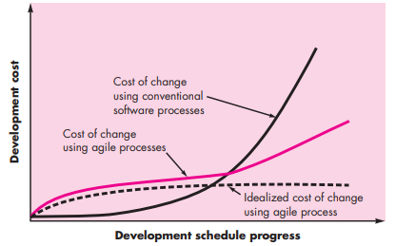
Cost of Change in Agile

Slide 41
HAVE A GOOD DAY!

